Slide 1
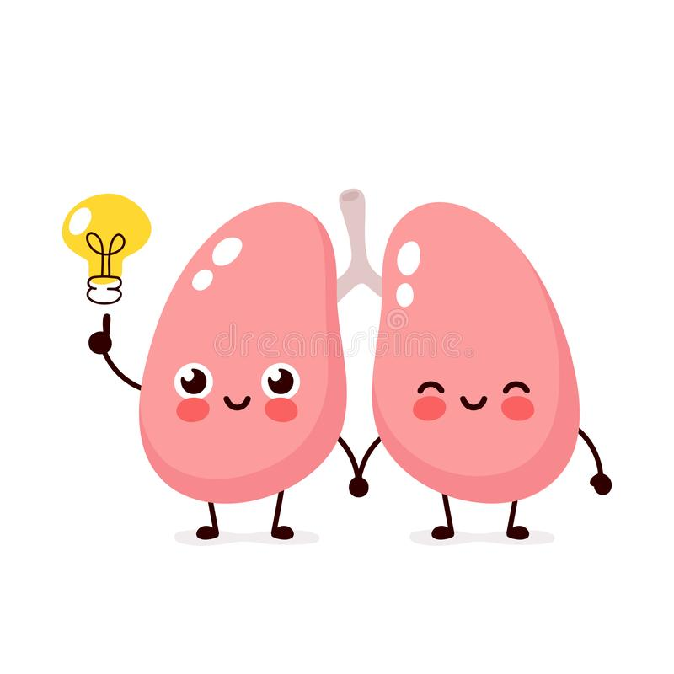
Gaseous Exchange Through Alveolar Membrane
Dr. Tabish Masood Ranjha

Slide 2
The purpose of the respiratory system is to perform gas exchange.
Pulmonary ventilation provides air to the alveoli for this gas exchange process.
At the respiratory membrane, where the alveolar and capillary walls meet, gases move across the membranes, with oxygen entering the bloodstream and carbon dioxide exiting.
It is through this mechanism that blood is oxygenated and carbon dioxide, the waste product of cellular respiration, is removed from the body.

Slide 3
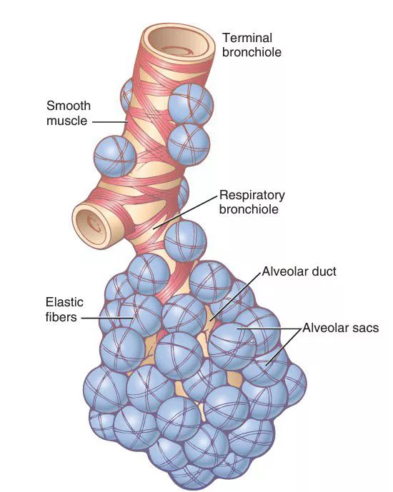
RESPIRATORY UNIT/LOBULE
Respiratory lobule is composed of
Respiratory bronchiole
Alveolar ducts
Atria
Alveoli
300 million alveoli in both lungs
Each alveolus has a diameter of 0.2mm
Extremely thin walled, in between two alveoli is a network of capillaries.

Slide 4
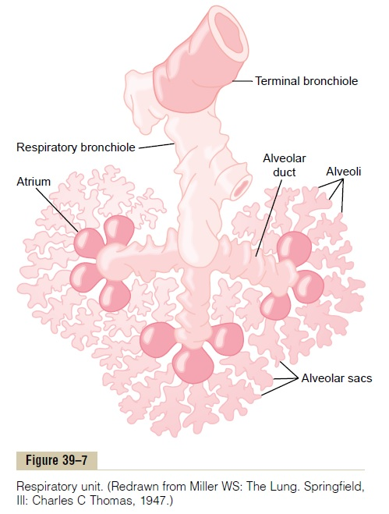
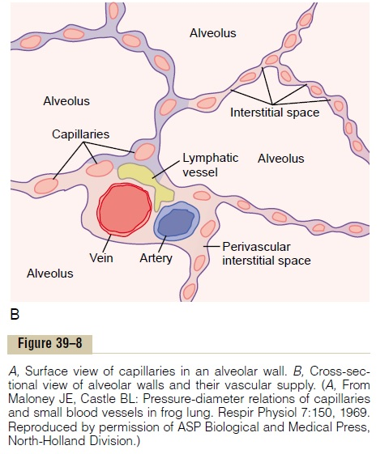

Slide 5
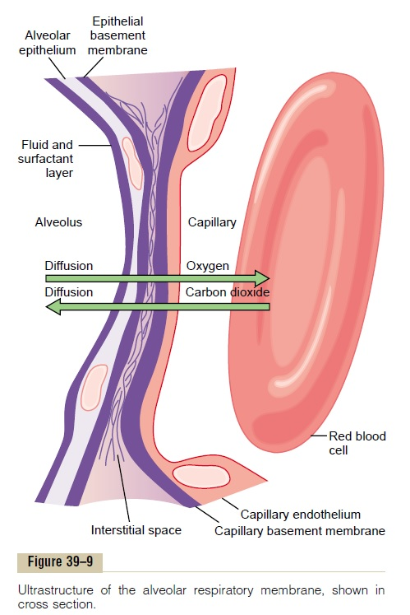
RESPIRATORY MEMBRANE
Gas exchange between alveolar air and pulmonary blood occurs through membranes of all terminal portions of lungs not merely at alveoli.
All these membranes are called respiratory membranes or Pulmonary membrane.
Oxygen diffuses from alveolus to red blood cell whereas carbon dioxide diffuses in the opposite direction.

Slide 6
LAYERS OF RESPIRATORY MEMBRANE
3
2
1
Despite all these layers, the thickness of membrane ranges from 0.2 to 0.6mm.
The total surface area of the respiratory membrane is about 70 square meters which is equal to floor area of a 25 × 30-foot room.
Total blood in capillaries at any given moment is 60-140ml.
4
6
5

Slide 7
FACTORS AFFECTING DIFFUSION
thickness of the membrane,
surface area of the membrane,
diffusion coefficient of the gas in the substance of the membrane
partial pressure difference of the gas between the two sides of the membrane.
FICK’S LAW for Gas Diffusion Volume = (A * Δpp * D)
T
A is cross sectional area of membrane
Δpp is the driving pressure (partial pressure difference)
D is gas coefficient
T is tissue thickness or length through membrane

Slide 8
Thickness of respiratory membrane
Rate of diffusion inversely proportional to membrane thickness
Increasing thickness by 2 – 3 times interferes significantly with normal respiratory exchange
Edema fluid & fibrosis increase thickness
Surface area of respiratory membrane
Decreases of surface area to ¼ normal impedes gas exchange significantly
Emphysema – dissolution of many alveolar walls to coalesce alveoli into larger chambers (surface area decreased as much as 5-fold)
Removal of lung tissue during surgery can be detriment to gas exchange

Slide 9
Diffusion coefficient (D)
D=Solubility/Molecular Wt.
Directly proportional to solubility
Inversely proportional to Wt.
CO2 diffuses 20 times faster than Oxygen
Oxygen diffuses twice as rapidly as nitrogen
Pressure difference across the respiratory membrane
Difference in partial pressures of gas in alveoli & pulmonary blood
This pressure difference is measure of net tendency for gas molecules to move through the membrane
Diffusion occurs across the membrane down the pressure gradient, simple diffusion

Slide 10
DIFFUSING CAPACITY OF RESPIRATORY MEMBRANE
The volume of a gas that will diffuse through the mem-brane each minute for a partial pressure difference of 1 mm Hg.

Slide 11
Diffusing Capacity of Oxygen
Volume of diffused gas= Diffusing capacity × Pressure Difference
The diffusing capacity for oxygen =21 ml/min/mm Hg.
The mean oxygen pressure difference =11 mm Hg
Total oxygen uptake= (11mmHg× 21ml) =230ml per minute at Rest.
This rate of diffusing capacity increases up to three times during strenuous exercise.
This is due to
opening up of many previously dormant pulmonary capillaries or extra dilation of already open capillaries
a better match between the ventilation of the alveoli and the perfusion of the alveolar capillaries with blood, called the ventilation-perfusion ratio

Slide 12
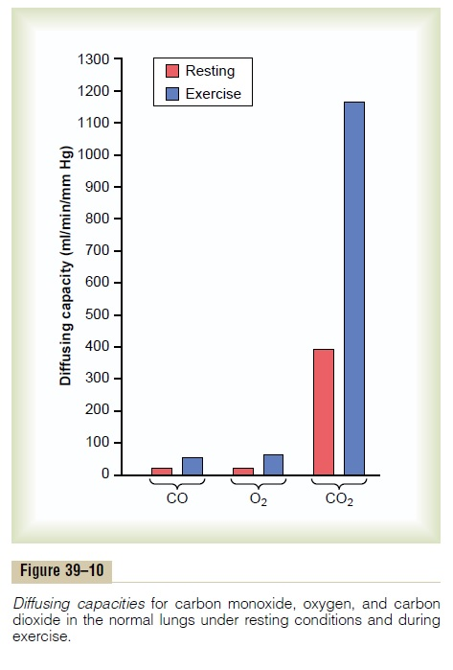
Diffusing Capacity For Carbon dioxide
Carbon dioxide diffuses 20 times more rapidly than O2.
At rest, Co2 diffusing capacity= 400-450ml/min
During Exercise= 1200 to 1300ml/min

Slide 13
VENTILATION & PERFUSION
VENTILATION (V)
The rate at which air enters or leaves the lungs.
Types :
Pulmonary Ventilation
Alveolar Ventilation
PERFUSION (Q)
The volume of blood reaching the alveoli via pulmonary vessels including Pulmonary artery, smaller arteries, and arterioles.

Slide 14
1) Pulmonary Ventilation (minute ventilation or respiratory minute volume)
Volume of air moving in and out of respiratory tract in a given unit of time during quiet breathing
Pulmonary Ventilation= Tidal volume X Respiratory Rate
= 500 ml x 12/minute
= 6000 ml/minute
2) Alveolar ventilation: It is the amount of air utilized for gaseous exchange every minute.
Alveolar ventilation
= (Tidal volume – Dead space) X Respiratory Rate
= ( 500 – 150 ) ml x 12/minute
= 4200ml/minute

Slide 15
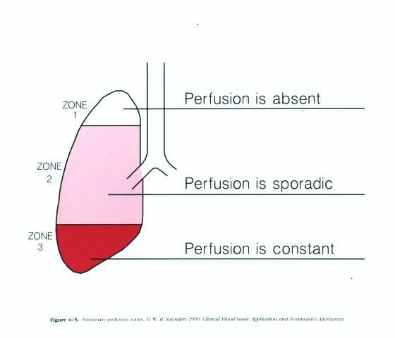
ZONES OF PERFUSION
Pulmonary distribution of blood flow is in three zones
Zone 1 (no flow)
Zone 2 –Apex (intermittent flow)
Zone 3- Base(Continuous flow)

Slide 16
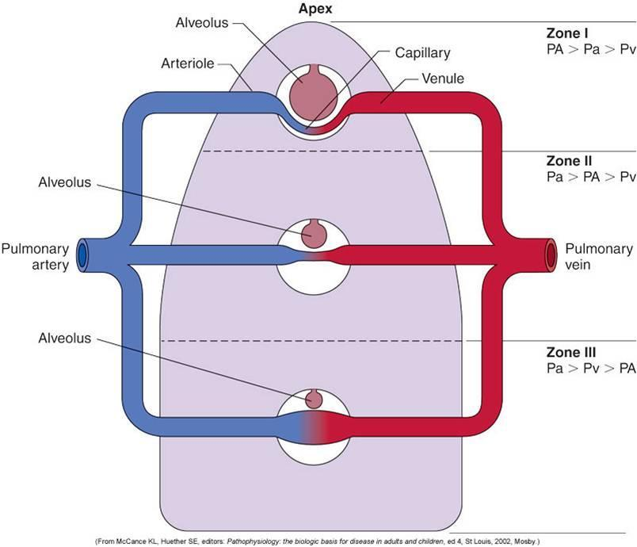
Zone 1
↑ Intrapleural alveolar pressure,
↓ Arterial pressure due to gravity
No perfusion
Zone 2
Arterial pressure greater than alveolar and venous pressure, hence intermittent perfusion
Zone 3
Smaller alveoli, lowest alveolar pressure
Greater arterial pressure due to gravity
Maximal Perfusion

Slide 17
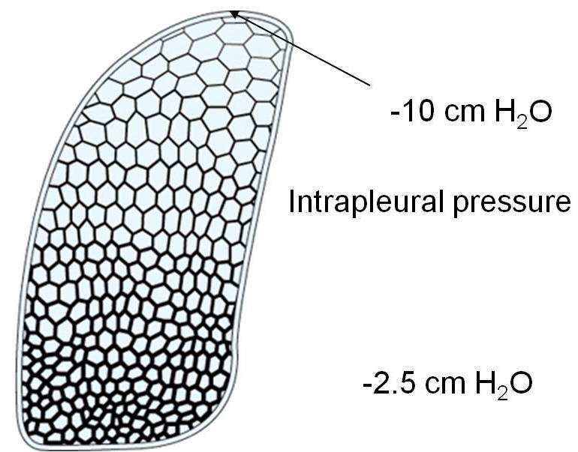
ZONES OF VENTILATION
Zone 1
Greater diameter of alveoli, maximal ventilation
Zone 2
Intermittent size of alveoli
Zone 3
Smallest size of alveoli

Slide 18
Ventilation/Perfusion (V/Q) Ratio
It is the ratio of alveolar ventilation and the amount of blood that perfuse the alveoli.
V/Q= alveolar ventilation ÷ pulmonary blood flow
Alveolar ventilation (V)= 4200ml/minute
Pulmonary blood flow(Q)=5000ml/minute
So, V/Q= 0.84

Slide 19
Alveolar PO2 and PCO2 is determined by two factors
Rate of alveolar ventilation (VA)
Rate of transfer of O2 ,CO2 through respiratory membrane (Rate of blood flow) (Q)

Slide 20
V/Q In ZONES OF LUNGS
Zone 1: Ventilation(V) >>> Perfusion(Q)
V/Q= 3.4 (high)
Zone 2: Ventilation(V) = Perfusion(Q)
V/Q= 0.8 (average)
Zone 3: Perfusion(Q) >>> Ventilation(V)
V/Q=0.63(low)

Slide 21
VA⁰ / Q⁰ – Zero; When ventilation is zero, but perfusion is still there.
PO₂ =40 mm Hg PCO₂ = 45 mm Hg
VA⁰ / Q⁰ - Infinity ; When ventilation is adequate but perfusion is zero.
PO₂ = 149 mm Hg PCO₂ = 0 mm Hg
VA⁰ / Q⁰ – Normal ;When ventilation and perfusion are normal
PO₂ = 104 mm Hg PCO₂ = 40 mm Hg

Slide 22
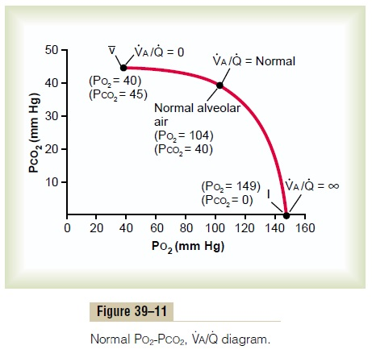
V/Q=0
No alveolar ventilation. (V=0)
Venous blood returning to lungs from the body present in capillaries
The alveolar air equilibrates itself with venous O2 and CO2.
Hence, pO2= 40mmHg , pCO2= 45mmHg, similar to venous pressures.

Slide 23
V/Q=∞
No perfusion (Q=0), no capillary flow to carry O2 away or bring CO2 to alveoli.
Alveolar air equilibrates itself with humidified inspired air
No gaseous exchange occurs
Hence,
pO2=Normal inspired air= 149mmHg
pCO2= 0mmHg

Slide 24
V/Q=Normal
Normal alveolar ventilation and perfusion
Optimal exchange of O2 and CO2
Hence.
pO2= 104mmHg
pCO2=40mmHg

Slide 25
PHYSIOLOGICAL SHUNT
V/Q is below normal
Inadequate ventilation, hence, a certain fraction of blood perfused is not oxygenated. This is called shunted blood.
2% of the cardiac output, via bronchial vessels is also unoxygenated.
Total quantitative amount of shunted blood per minute is called physiological shunt.

Slide 26
PHYSIOLOGICAL DEAD SPACE
V/Q is greater than normal.
Low amount of perfusion but more than adequate ventilation, far more oxygen is available and hence ventilation is said to be wasted.
Ventilation of anatomical dead spaces also wasted
Cumulative of these two wasted ventilations is called physiological dead space.
When physiological dead space is great, work of ventilation is wasted as due to low perfusion, much of the ventilated air never reaches the blood.

Slide 27
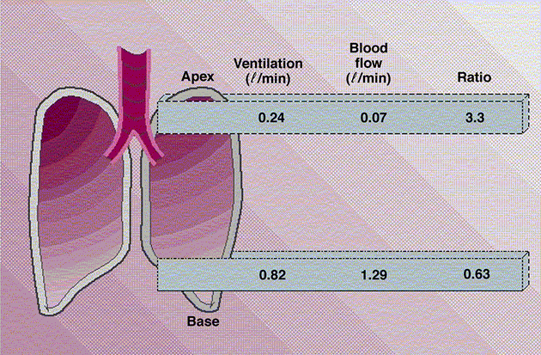
ABNORMALITIES OF V/Q
In a normal lung, there is a V/Q mismatch in upper and lower lung.
At top of lung, V/Q is 2.5 times greater than ideal value, due to low perfusion, causing physiologic dead space.
At the bottom of lung/Q is as low as 0.6 times the ideal value, the ventilation is inadequate to the blood flow, leaving some blood non-oxygenated as physiologic shunt.

Slide 28
VENTILATION PERFUSION MISMATCH
Chronic obstructive disorders
VA⁰ / Q⁰ Below normal
As, Q= Normal
V= low
Pulmonary Emphysema
VA⁰ / Q⁰ Above normal
As, V= Above normal
Q= Normal
Inadequate oxygenation, Hypoxemia
Increased dead space ventilation
Shunt-like mixing
Respiratory failure

Slide 29
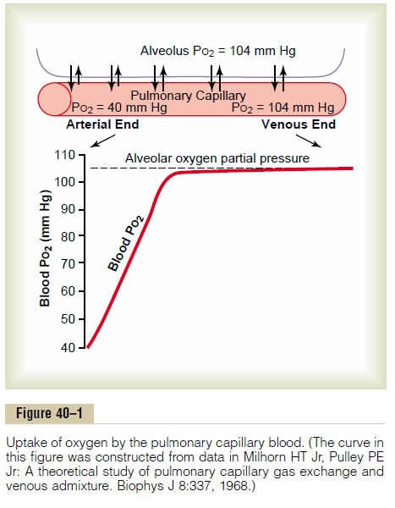
Transport of oxygen
Oxygen diffuses out of the alveoli into the capillary bed at the respiratory membrane due to difference in partial pressures.
Upon reaching the tissues, a similar pressure difference is created as pO2 in capillary blood is higher as compared to the tissues, hence, once again oxygen diffuses out into the tissues.
Conversely, CO2 is released from tissues to capillary blood once oxygen is metabolized in the cells.
As blood flows to the lungs, CO2 diffuses out of the blood to alveoli because pCO2 in capillary blood is higher than alveoli.

Slide 30
pO2 at the gaseous alveolus is 104mmHg
pO2 at the capillary end is only 40mmHg
This creates an initial pressure difference of 64mmHg causing alveolar pO2 to diffuse into the capillary.
As the blood passes through the capillary there is rapid rise in the pO2 to almost that of the alveolar air.
98% of blood is oxygenated here
2% is in the shunt flow to bronchial circulation

Slide 31
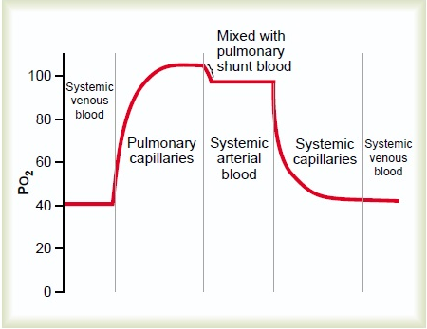
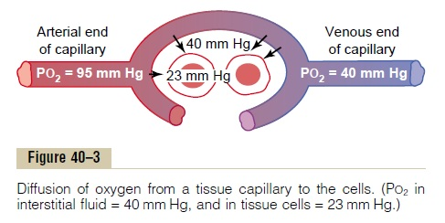
Upon leaving the lungs the pO2 of capillary blood is 104mmHg, whereas pO2 of shunt flow is 40mmHg.
This combines in the pulmonary veins, venous admixture of blood, causing the pO2 of blood entering the left heart and aorta to fall to about 95mmHg.
When this reaches the interstitium of tissues, pO2 of fluid is 40mmHg and that of tissues is 23mmHg. This pressure difference causes O2 to diffuse rapidly into the tissue cells.
pO2 entering systemic veins is hence, about 40mmHg.

Slide 32
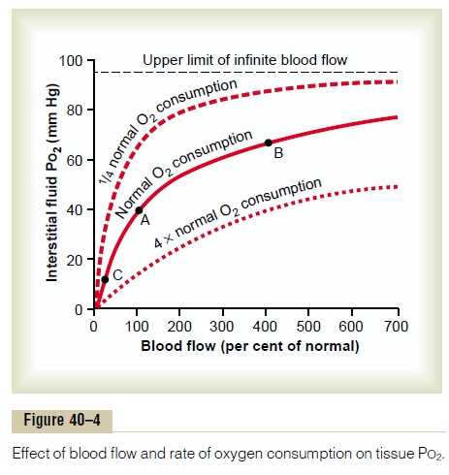
Increasing tissue blood flow increases O2 transported to cells.
400 times the flow increases pO2 by 66mmHg, and up to 95mmHg at the maximal blood flow
If the cells use more O2, interstitial pO2 is reduced
When consumption by cells is decreased pO2 of interstitial fluid is conversely increased.

Slide 33
Role of hemoglobin in transport
97% oxygen is transported in combination with hemoglobin.
3% is dissolved in water of plasma and blood cells.
O2 binds reversibly with Hb.
If pO2 is high, oxygen binds with Hb, if pO2 is low as in tissues, Hb releases O2.
One gram of Hb can bind 1.34 ml of Oxygen
Normal level of Hb is 15 grams/dL
Thus 15 grams of hemoglobin in 100 milliliters of blood can combine with a total of almost exactly 20 milliliters of oxygen if the hemoglobin is 100 per cent saturated
This is usually expressed as 20 volumes per cent

Slide 34
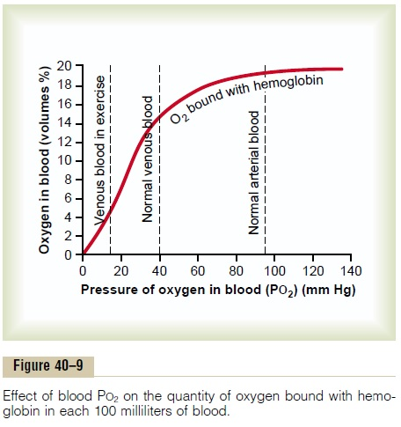
O2 bound with hemoglobin in systemic arterial blood is 97% saturated, about 19.4ml per 100ml blood.
On passing capillaries, it is reduced to 14.4ml.
Only about 5ml of O2 is transported from lungs to tissues per 100ml flow.
During exercise, cellular O2 consumption increases, interstitial pO2 falls from 40mmHg to 15mmHg.
Only 4.4ml remains bound and 15ml of O2 is delivered to cells.

Slide 35
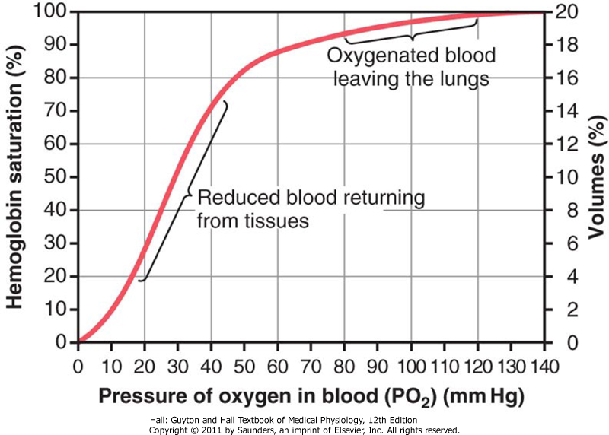
Oxygen-hemoglobin dissociation curve
The oxygen-hemoglobin dissociation curve is a graphical representation of the relationship between partial pressure of oxygen (PaO2) and the saturation of hemoglobin with oxygen (SaO2).
● SaO2 = % of hemoglobin (Hb) bound to oxygen
● PaO2 = amount of oxygen dissolved in blood
It shows that % of Hb saturation increases with increase in PO2, but this relationship is not linear but sigmoid shaped.

Slide 36
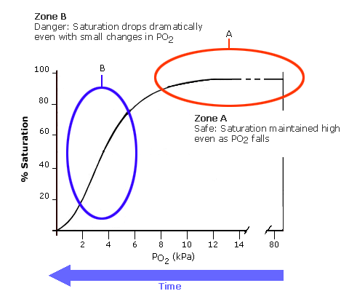
Loading zone refers to O2 uptake in lungs, higher affinity of Hb for O2 here.
Unloading zone refers to release or dissociation of O2 from Hb at cellular level to make O2 readily available.
A small change in pO2 can dramatically affect the oxy-hemoglobin dissociation.
The curve can be either shifted to Right or Left depending upon multiple factors.
Loading zone
Unloading

Slide 37
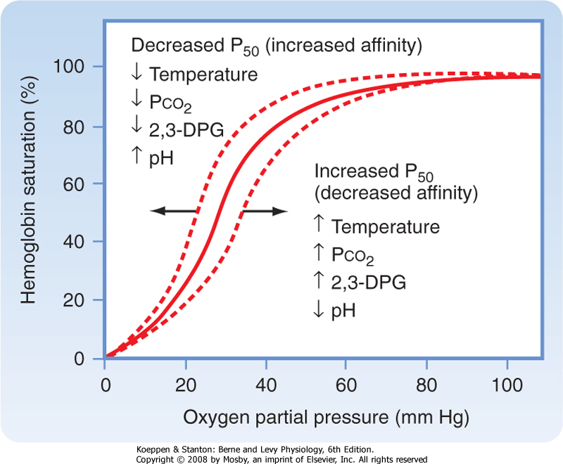
A shift to the right means increased release of O2 at a lower pO2 from blood into tissues due to increased dissociation.
Factors causing right shift
Increased CO2 concentration(Bohr’s effect)
Increased temperature
Increased 2,3 BPG(hypoxia ↑ BPG)
Increased H+ Ions
Reduced pH
Exercise indirectly increases above factors
BOHR’S EFFECT
Raised blood CO2 and H+ enhances release of O2 from Hb.
Raised CO2 causes increased carbonic acid and H+ concentration, forcing O2 away from Hb and into cells.

Slide 38
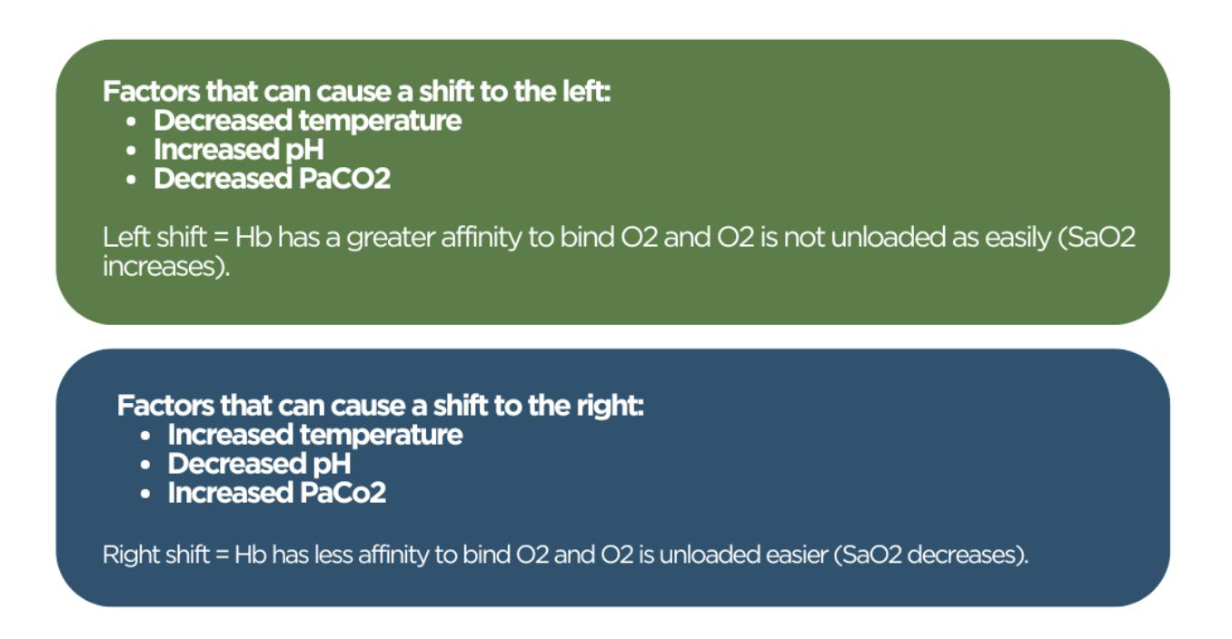

Slide 39
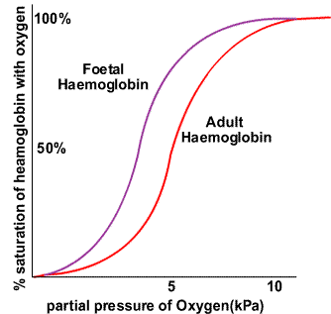
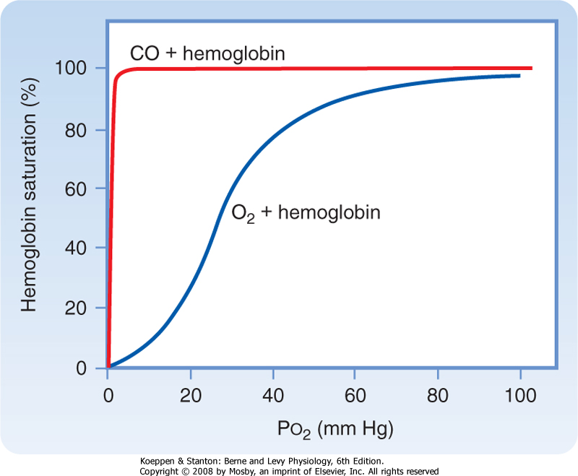
Left shift
FETAL HEMOGLOBIN
CO POISONING

Slide 40
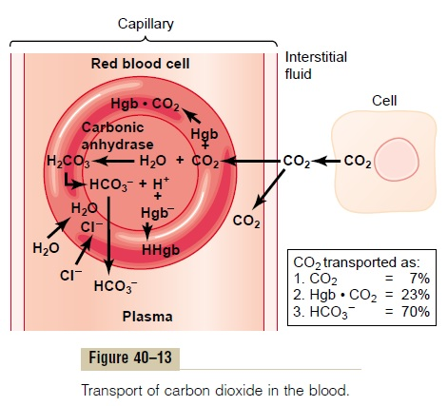
Transport of carbon dioxide
Carbon dioxide diffuses out of the tissue cells in the dissolved molecular carbon dioxide form.
On entering the tissue capillaries, the carbon dioxide is converted to carbonic acid
pCO2 venous blood is 45mmHg
pCO2 arterial blood is 40mmHg
Only a small difference is sufficient to initiate diffusion

Slide 41
Forms of transport
Dissolved in Plasma:
About 7% of CO₂ is transported in dissolved form.
Contributes to the partial pressure of CO₂ in blood.
Bound to Hemoglobin (Carbaminohemoglobin):
CO₂ binds to the amino groups of hemoglobin.
Accounts for approximately 23% of CO₂ transport.
As Bicarbonate Ions (HCO₃⁻):
The majority (70%) of CO₂ is transported as bicarbonate ions.
The Chloride Shift or Hamburger Phenomenon
Catalyzed by the enzyme carbonic anhydrase in red blood cells.

Slide 42
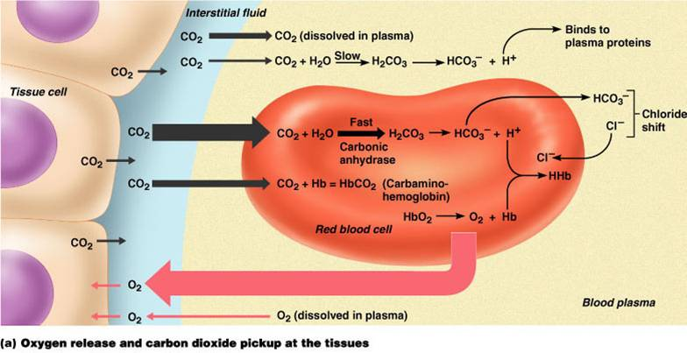

Slide 43
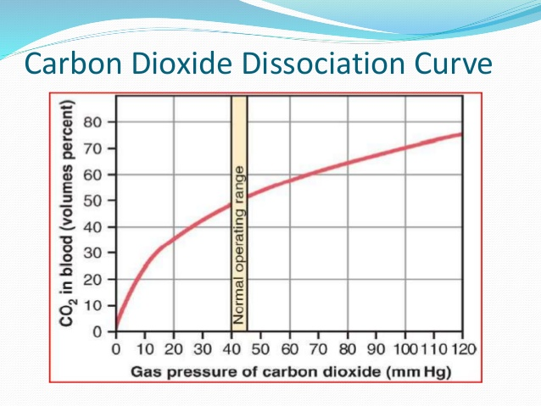
Carbon dioxide dissociation curve
Relationship between PCO2 & total CO2 content.
Relationship is nearly linear over wide range of PCO2

Slide 44
FACTORS AFFECTING CO2 DISSOCIATION CURVE
This combination of CO2 with Hb -Reversible
Slower than reaction of CO2 with water as more CO2 transported as Bicarbonates (70%) than carbamino compounds (23%)

Slide 45
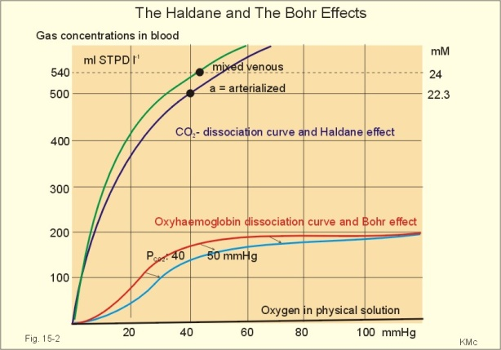
FACTORS AFFECTING CO2 DISSOCIATION CURVE
OXYGEN
DPG
BODY TEMPERATURE.

Slide 46
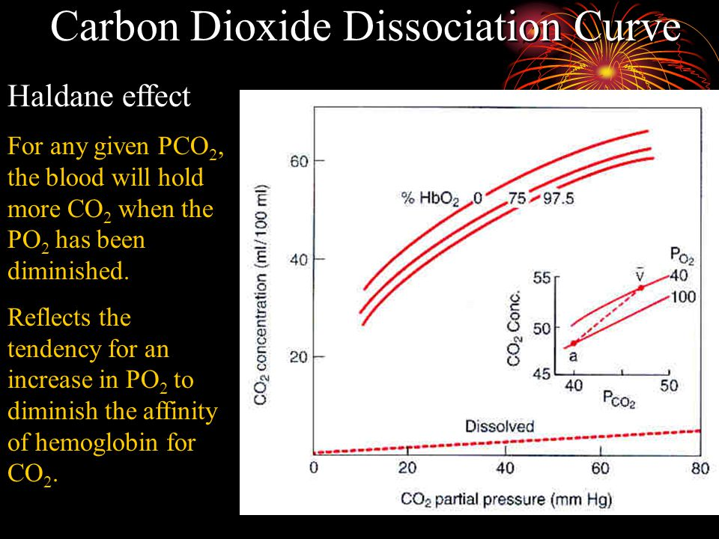
OXYGEN
Deoxyhemoglobin is capable of loading more Co2 than oxyhemoglobin.
Also, oxygenation of Hb in lungs increases Co2 unloading – Haldane Effect.
For any given pCO2, the blood will hold more CO2 when pO2 is reduced.

Slide 47
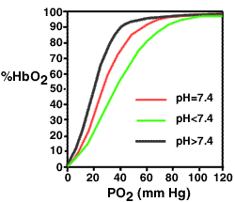
OXYGEN
Blood with PCO2 40 mmHg reaching the tissue is capable of drawing CO2 more at PO2 40 mm Hg than at PO2 100 mmHg. So, dissociation curve shifts to left in tissue.
Blood with pCO2 45 mmHg reaching the lung is capable of leaving CO2 more at PO2 100 mm Hg than at PO2 40 mmHg. So, dissociation curve shifts to right in lungs.

Slide 48
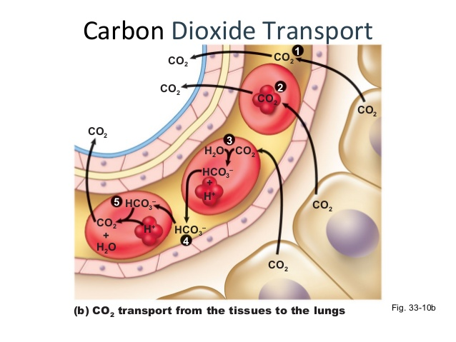
RELEASE OF CO2 IN LUNGS.
Venous blood with PCO2 45 mm Hg & PO2 40 mm Hg contains CO2 52ml/100 ml.
Alveolar air with Pco2 40 mmHg, PO2 100 mmHg contains CO2 48ml/100ml.
So total diffusion of 4 ml/100 ml.

Slide 49
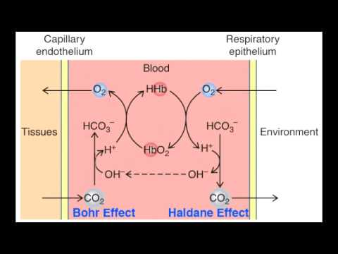
RELEASE OF CO2 FROM CARBAMINOHAEMOGLOBIN INTO PLASMA
O2 enters the RBC
Converts Deoxy Hb – to Oxy Hb
Oxy-Hb has low affinity for CO2
CO2 released into plasma from Carbaminohemoglobin.

Slide 50
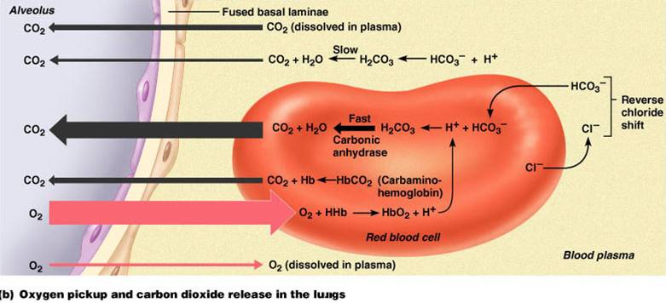
RELEASE OF CO2 FROM CARBONATE INTO PLASMA
Oxyhemoglobin is strong acid – increases H+ ion conc – to neutralize HCO3- ions enters RBC & Cl⁻ ions leaves RBC
Reversal of chloride shift.

Slide 51
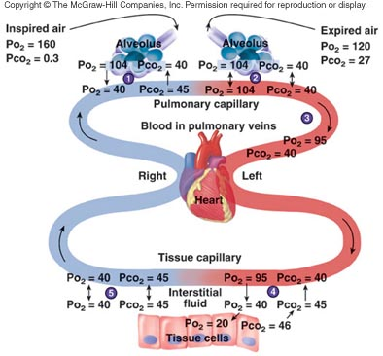
DIFFUSION OF CO2 FROM PLASMA TO ALVEOLI
PCO2 of plasma of capillary arterial blood 45 mm Hg & PCO2 of alveolar air is 40 mm Hg.
Pressure gradient of 5 mm Hg
Co₂ transported from plasma to alveoli.

